Slide 1
Keypad interfacing (port multiplexing)
Keyboards are organized in a matrix of rows and columns
When a key is pressed a row and a column make contact, otherwise there is no connection between them
With 8-bit PORT 4x4 matrix of keys can be connected to a microcontroller.

Slide 2
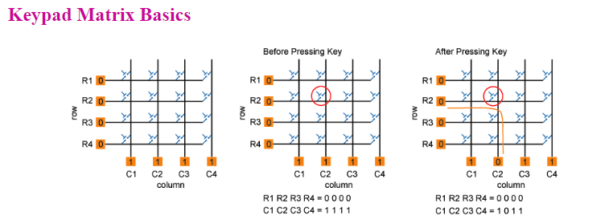

Slide 3
How it works ???
The hex keypad has 8 communication lines namely
R1, R2, R3, and R4
C1, C2, C3, and C4
R1 to R4 represents the four rows
C1 to C4 represents the four columns
When a particular key is pressed the corresponding row and column to which the terminals of the key are connected gets shorted.
For example if key 1 is pressed row R1 and column C1 gets shorted and so on

Slide 4
Key Scanning:
To detect a pressed key, the microcontroller grounds all rows by providing 0 to the output latch, and then it reads the columns
If the data read from columns is = 1111, no key has been pressed
After pressing key, it makes contact of row with column
If one of the column bits has a zero, this means that a key press has occurred. For example, if C1:C4 = 1011, this means that a key in the C2 column has been pressed.
After detecting a key press, microcontroller will go through the process of identifying the key.

Slide 5
Starting from the top row, the microcontroller will ground it by providing a low to row R1 only.
Now read the columns, if the data read is all 1s, no key in that row is pressed and the process continues for the next row.
So, now ground the next row, R2. Read the columns, check for any zero and this process continues until the row is identified. E.g. In above case we will get row 2 in which column is not equal to 1111. So, after identification of the row in which the key has been pressed we can easily find out the key by row and column value.

Slide 6
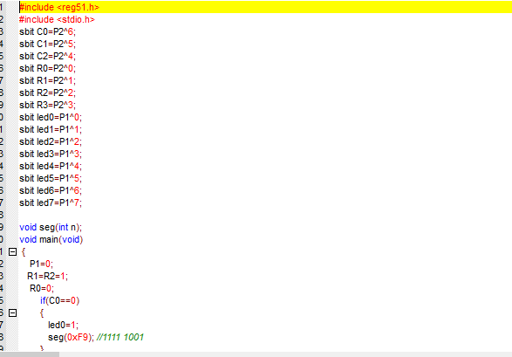

Slide 7
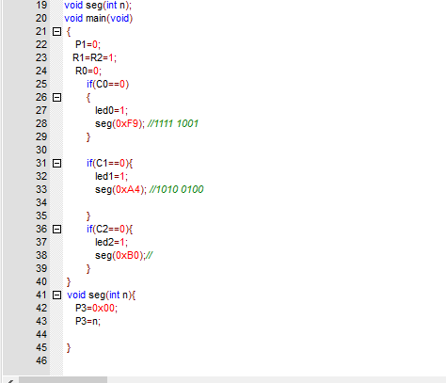

Slide 8
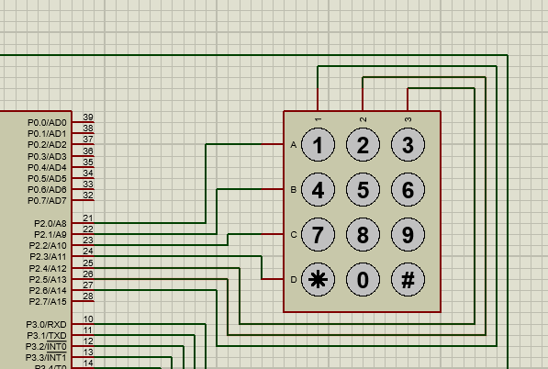

Slide 9
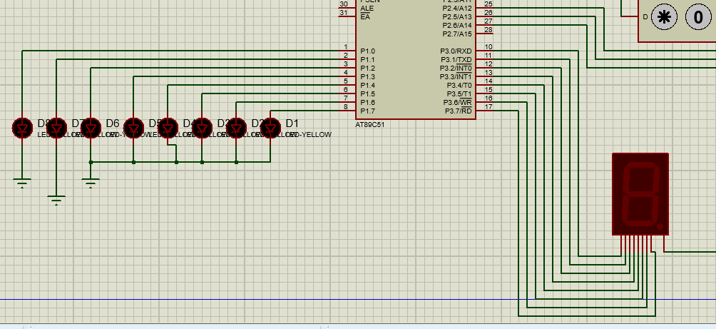

Slide 10
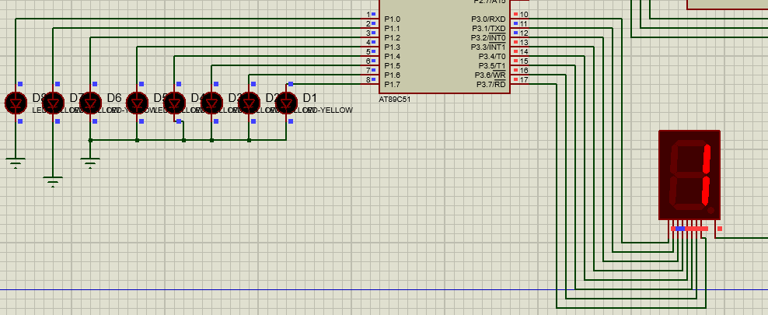

Slide 11
TASKS:
1) Run the program given in the lecture
2) Display Numbers from 1 to 9 on the seven segment display and ON the corresponding LED’s attached with P1
Note: Attach the seven segment with P3 and keypad with P1.

